Slide 1
MLOps Introduction
The Hoang
Understand and Implement Production-Grade Machine Learning Operations

Slide 2
Lecture
Why MLOps?
What is MLOps?
Why is it important?
Overview of the MLOps lifecycle.
The MLOps Principles.
Key roles: Data Scientists, ML Engineers, DevOps.
Tools and Technologies in MLOps.

Slide 3
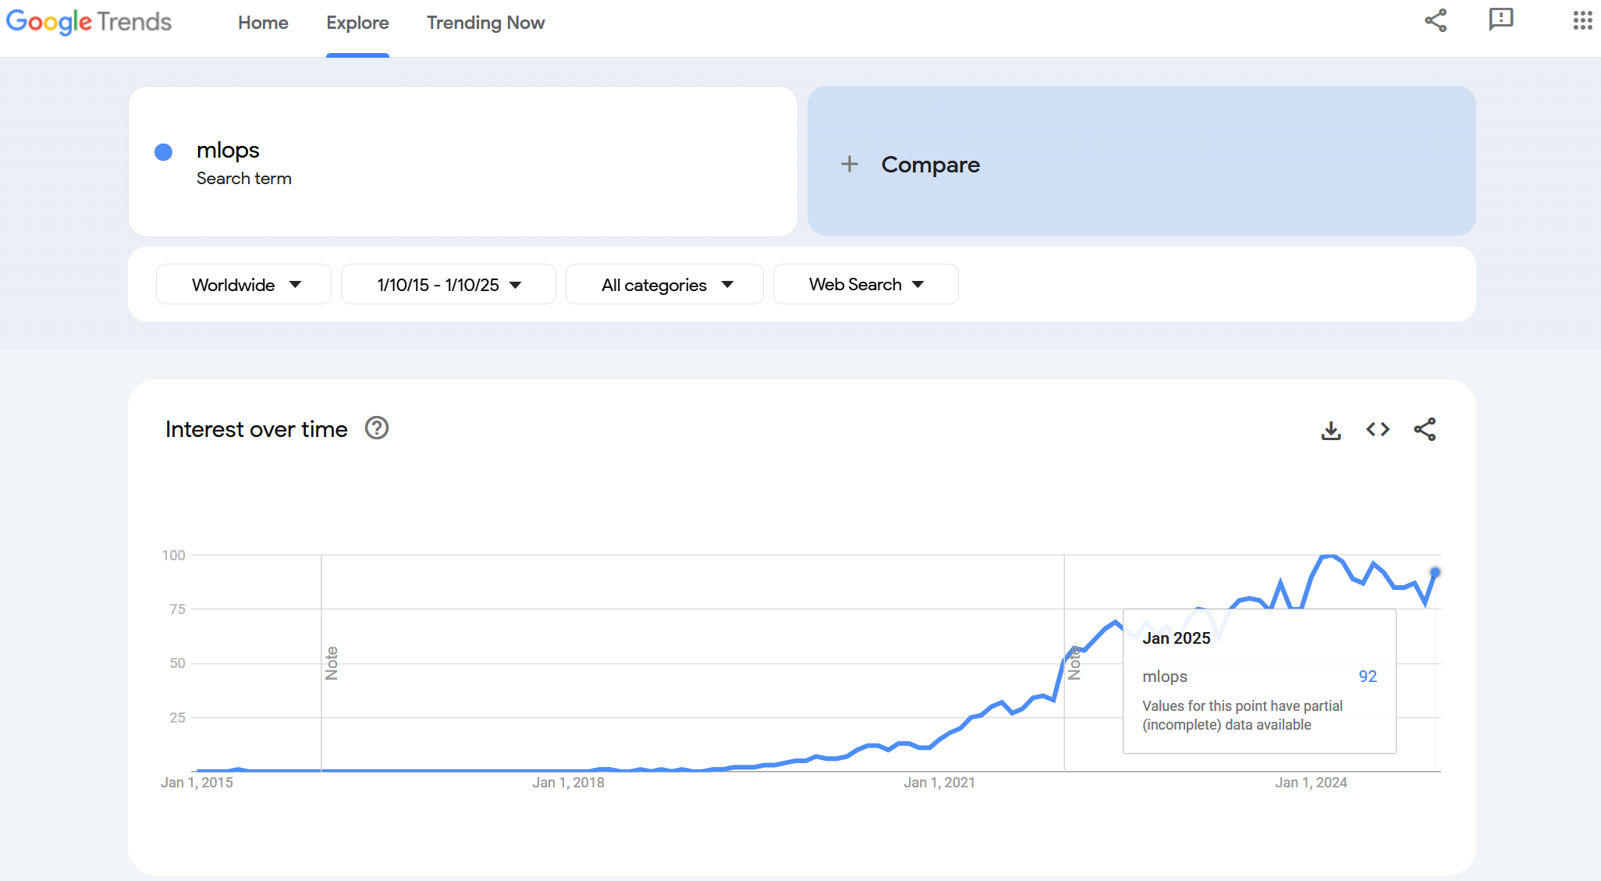
Why MLOps? – Propensity

Slide 4
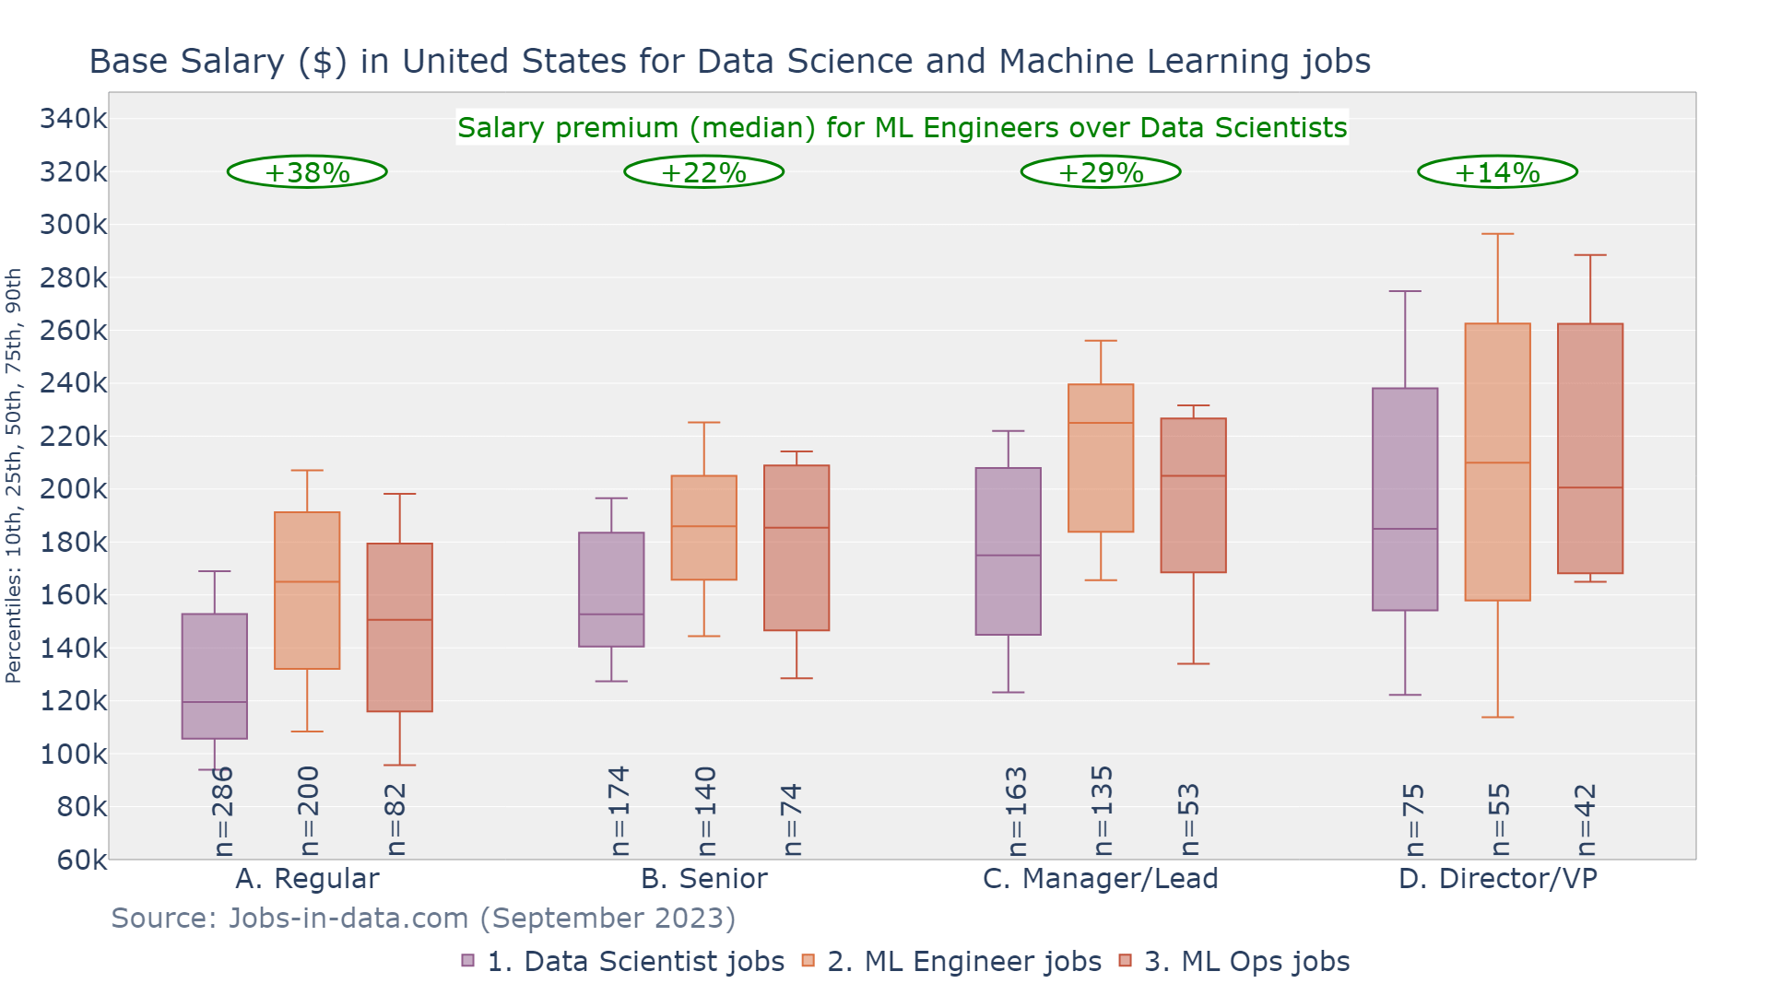
Why MLOps? – Career Prospects

Slide 5
What is MLOps?
MLOps (Machine Learning Operations) is a set of practices, tools, and frameworks designed to streamline and automate the deployment, monitoring, and management of machine learning (ML) models in production environments.
It is an extension of DevOps (Development + Operations) but specifically tailored for ML systems, which involve unique challenges, such as managing data, retraining models, and handling versioning of both code and models.

Slide 6
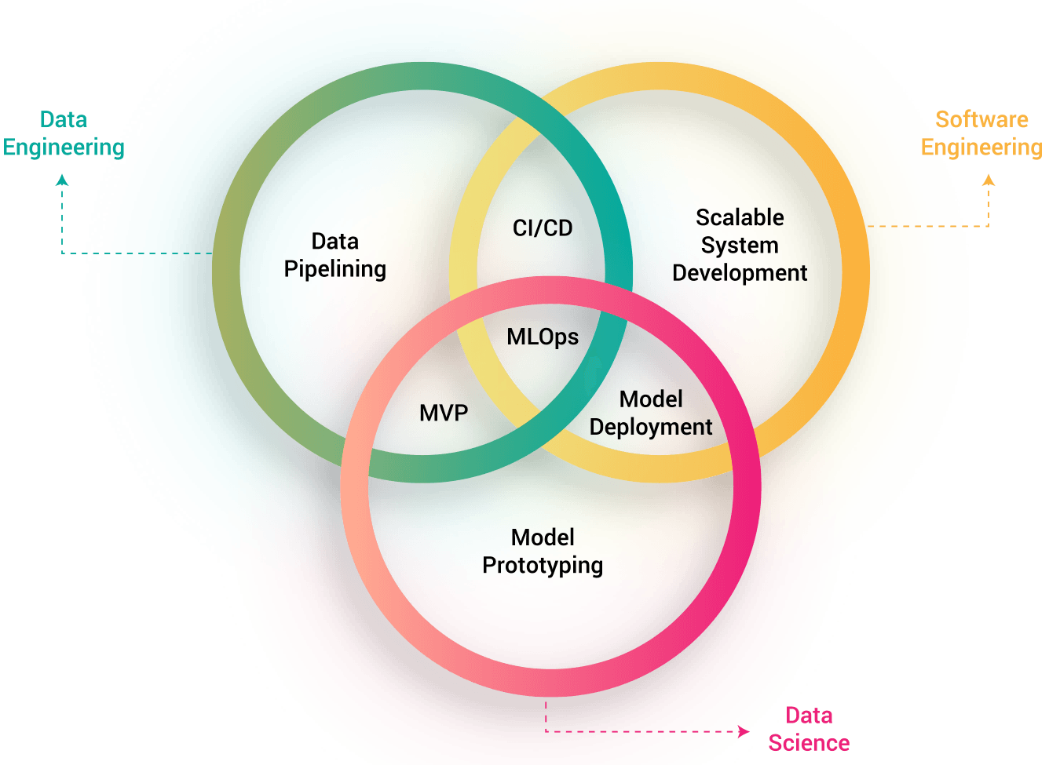

Slide 7
Why is it important? (1/10)
Streamlined Deployment Process
MLOps automates the deployment of machine learning models, reducing manual intervention and errors.
Ensures CI/CD pipelines for both code (software) and models, enabling faster and more reliable releases.

Slide 8
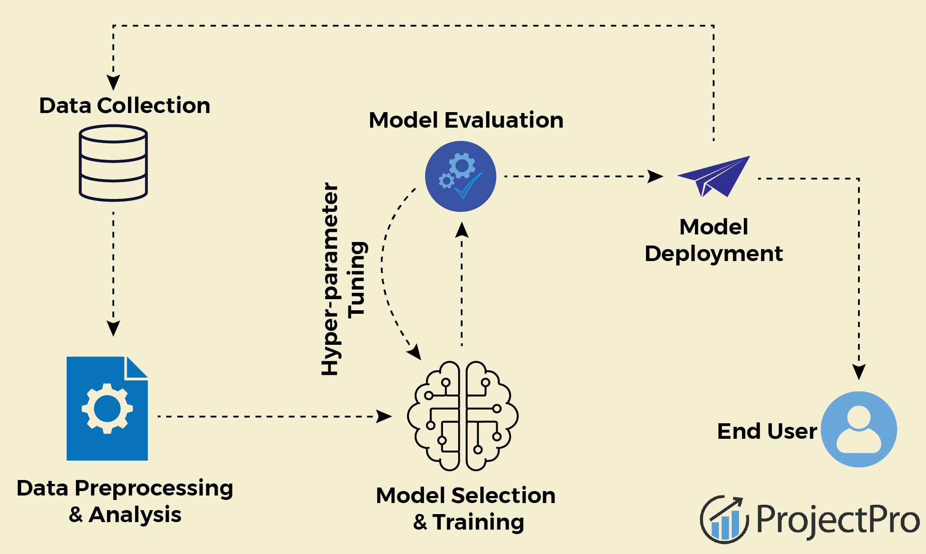

Slide 9
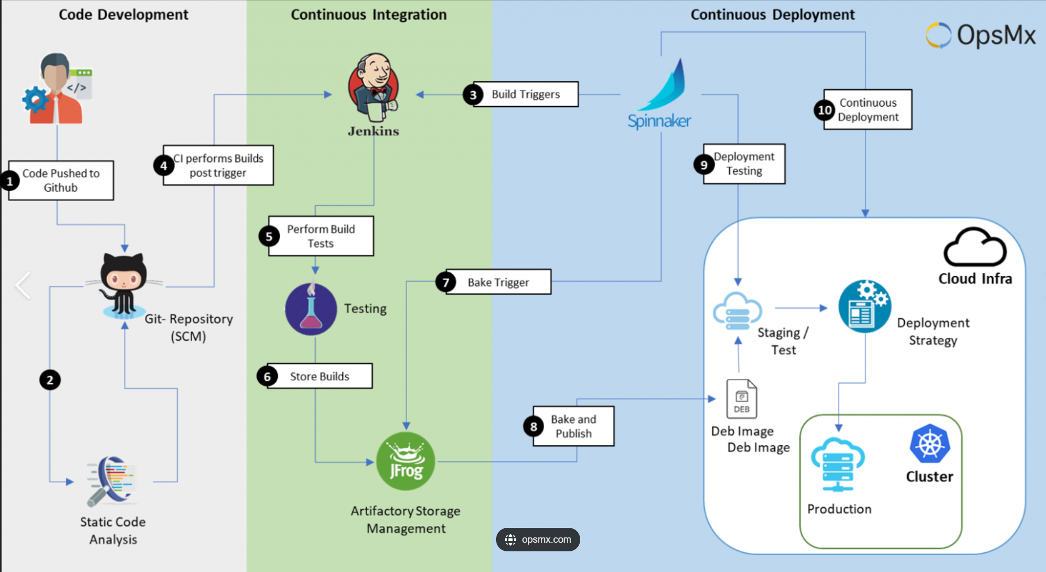
Why is it important? (1/2)

Slide 10
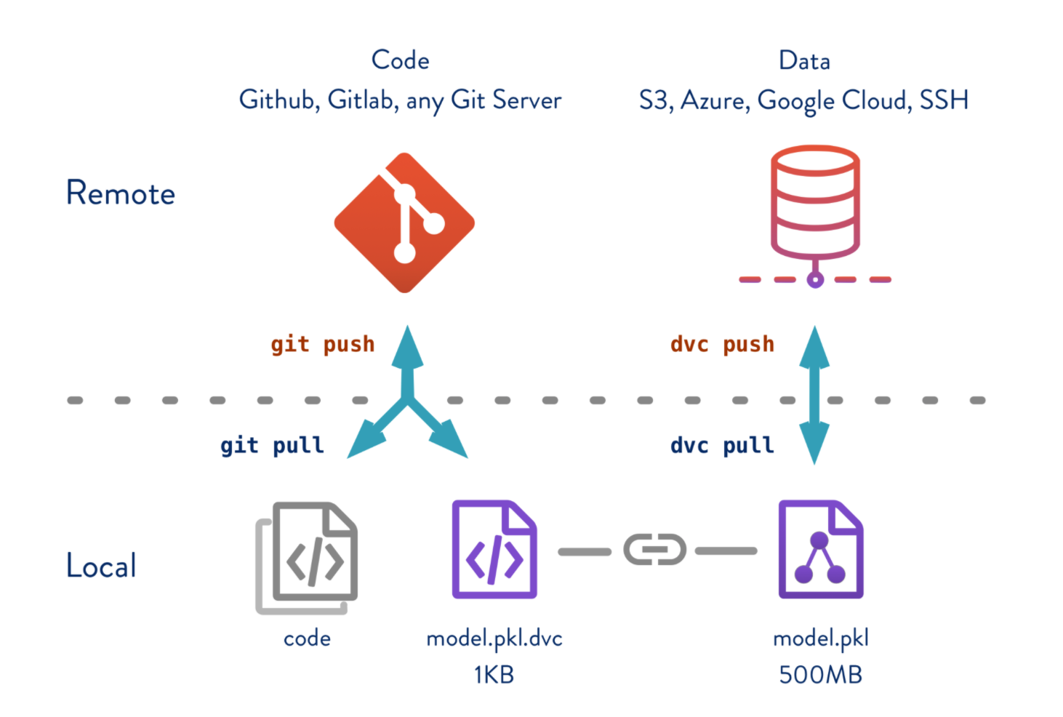
Why is it important? (2/10)
Model Versioning and Reproducibility
Tracks and manages different versions of models, datasets, and code to ensure reproducibility.
Allows teams to roll back to previous versions of models and experiments if issues arise.

Slide 11
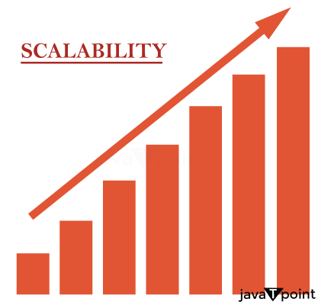
Why is it important? (3/10)
Scalability
Provides tools and frameworks to scale ML workflows as data and user demands grow.
Supports distributed training, large-scale data processing, and deployment across multiple environments (cloud, edge, or on-premises).

Slide 12
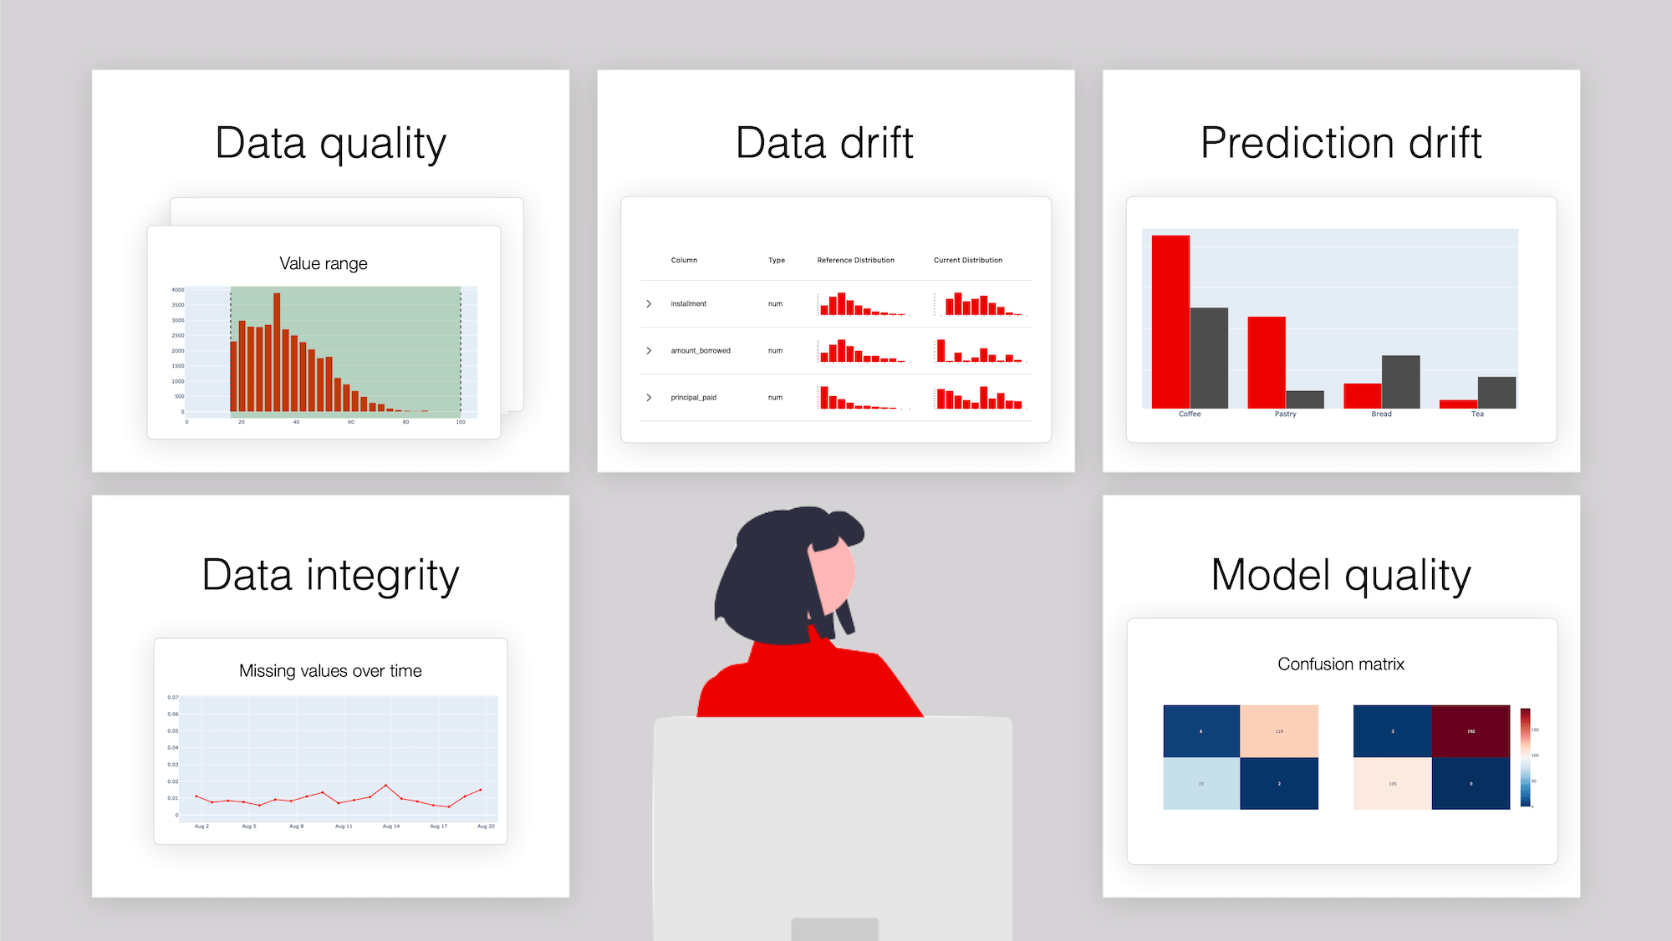
Why is it important? (4/10)
Monitoring and Model Performance Management
Enables real-time monitoring of model performance in production.
Tracks metrics like accuracy, latency, drift, and errors to ensure models are delivering expected results.
Detects concept drift or data drift, allowing for timely retraining or updates.

Slide 13
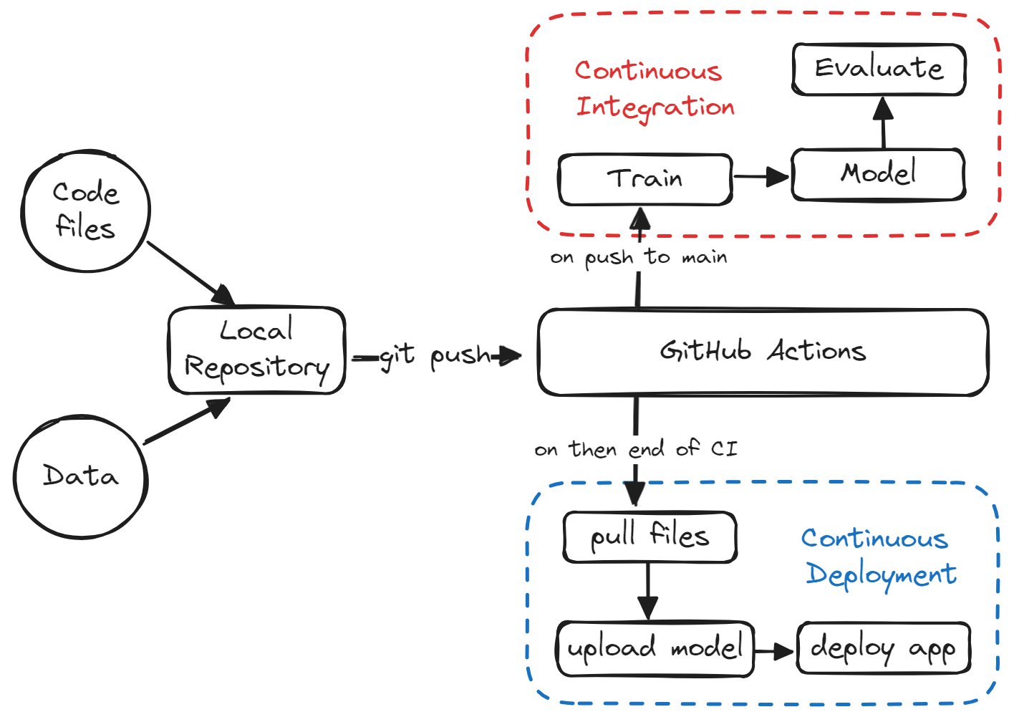
Why is it important? (5/10)
Automation of Retraining and Continuous Learning
Automates retraining pipelines when new data becomes available or when performance degrades.
Creates an ecosystem for continuous learning, keeping models up to date with changing patterns in the data.

Slide 14

Why is it important? (6/10)
Collaboration Between Teams
Promotes collaboration between data scientists, ML engineers, and DevOps teams.
Creates standard processes and tools that make it easier for teams to work together and share knowledge.

Slide 15

Why is it important? (7/10)
Efficient Resource Management
Optimizes infrastructure usage by dynamically allocating resources for training, testing, and serving models.
Reduces operational costs by integrating with cloud platforms and leveraging tools like Kubernetes or serverless computing.

Slide 16
Why is it important? (8/10)
Compliance and Governance
Ensures that machine learning workflows comply with regulations (e.g., GDPR, HIPAA) by tracking data lineage, audit logs, and model explainability.
Provides a framework for ethical AI, ensuring transparency and accountability in decision-making.

Slide 17
Why is it important? (9/10)
Improved Reliability and Fault Tolerance
Enhances the robustness of ML systems through redundancy, rollback mechanisms, and error-handling strategies.
Reduces downtime by enabling quick recovery from failures or bugs.

Slide 18
Why is it important? (10/10)
Faster Time-to-Market
Speeds up the transition from experimentation to production by automating repetitive tasks like feature engineering, model training, and deployment.
Shortens the feedback loop for model improvements, enabling businesses to iterate faster.

Slide 19
Example
Without MLOps: The data scientist trains the model, hands it over to the engineering team, and manually deploys it. Six months later, the model's performance deteriorates because of changes in fraud patterns, but there's no automated way to detect or fix it.
With MLOps: The bank uses an MLOps pipeline to continuously monitor the model, retrain it with fresh fraud data, and redeploy it automatically, ensuring consistent performance.

Slide 20
Overview of the MLOps Lifecycle – 1/
The MLOps lifecycle consists of several interconnected stages that ensure ML models are successfully developed, deployed, and maintained.

Slide 21
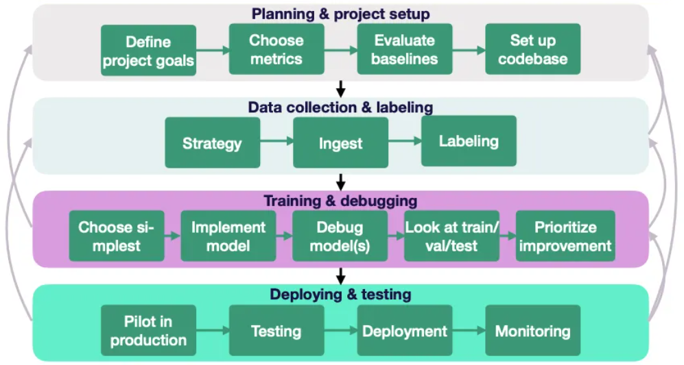
Overview of the MLOps Lifecycle – 2/

Slide 22
MLOps Lifecycle – 1/7
Problem Definition and Data Understanding
Collaborate with stakeholders to define the problem.
Gather and analyze data to understand its structure and quality.
Example: A retailer wants to predict customer churn. The data team collects transaction histories, demographics, and customer feedback.

Slide 23
MLOps Lifecycle – 2/7
Data Preparation
Clean, preprocess, and transform data into a usable format.
Split the data into training, validation, and test sets.
Example: Remove null values, encode categorical variables, and normalize numerical data for the churn dataset.

Slide 24
MLOps Lifecycle – 3/7
Model Development
Train multiple ML models (e.g., decision trees, neural networks) using the prepared data.
Evaluate models using metrics like accuracy, precision, recall, or F1 score.
Example: A data scientist trains a logistic regression model on customer data and evaluates it using AUC-ROC scores.

Slide 25
MLOps Lifecycle – 4/7
Model Packaging
Package the chosen model with its dependencies for deployment (e.g., using Docker or model serialization like pickle or ONNX).
Example: Save the trained churn prediction model as a .pkl file and build a Docker container to run it.

Slide 26
MLOps Lifecycle – 5/7
Model Deployment
Deploy the model to a production environment using APIs, batch systems, or streaming platforms.
Example: Host the churn prediction model on a REST API so customer data can be sent in real-time for predictions.

Slide 27
MLOps Lifecycle – 6/7
Monitoring and Maintenance
Track the model’s performance in production.
Detect and fix data or concept drift (when data patterns change over time).
Retrain the model as needed.
Example: Monitor the churn model's accuracy over time. If the accuracy drops below 90%, trigger a retraining pipeline.

Slide 28
MLOps Lifecycle – 7/7
Governance and Compliance
Ensure the system adheres to ethical standards, data privacy laws, and organizational policies.
Example: Document how the churn model makes predictions and verify compliance with GDPR.

Slide 29
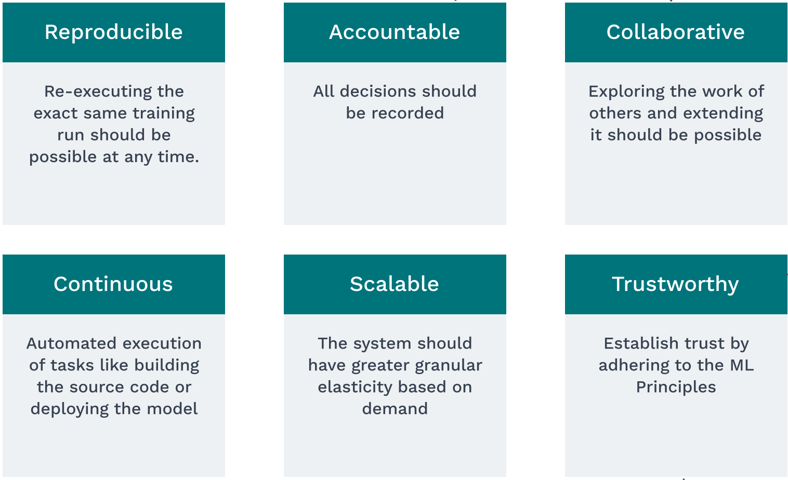
MLOps Principles

Slide 30
Key Roles in MLOps – 1/3
Data Scientists
Focus: Building machine learning models.
Skills: Data analysis, statistics, ML algorithms, Python/R, tools like Jupyter Notebook, TensorFlow, or Scikit-learn …
Role in MLOps:
Data exploration and preparation.
Training and fine-tuning models.
Handing off models to ML engineers for deployment.
Example Task: Train a recommendation system for an e-commerce site.

Slide 31
Key Roles in MLOps – 2/3
ML Engineers
Focus: Deploying and maintaining ML models in production.
Skills: Software engineering, APIs, Docker, Kubernetes, model serving frameworks (e.g., TensorFlow Serving, FastAPI) …
Role in MLOps:
Automate data pipelines, model training, and deployment.
Optimize model inference for low latency and scalability.
Example Task: Build a pipeline that automates retraining of the recommendation system when new data arrives.

Slide 32
Key Roles in MLOps – 3/3
DevOps (or MLOps Engineers)
Focus: Infrastructure, CI/CD, and monitoring systems.
Skills: Cloud platforms (AWS, GCP, Azure), CI/CD tools (Jenkins, GitHub Actions), logging/monitoring tools (Prometheus, Grafana).
Role in MLOps:
Set up infrastructure for model deployment and scaling.
Automate workflows for continuous integration and delivery.
Monitor production systems for failures or performance degradation.
Example Task: Configure a Kubernetes cluster to host the recommendation system and ensure it scales during peak traffic.

Slide 33
Tools and Technologies in MLOps
Category | Tools | Purpose | Example
Data Management | Apache Airflow, Prefect, Pachyderm, Kedro | Automates data pipelines, ensures data quality, and manages data lineage. | Use Apache Airflow to schedule daily data ingestion for a recommendation system.
Model Development | Jupyter, TensorFlow, PyTorch, Scikit-learn, Metaflow | Model training and experimentation. | Use PyTorch to train a computer vision model for object detection.
Version Control | Git (code), DVC (Data Version Control), MLflow | Track changes in code, datasets, and models. | Use DVC to version datasets and MLflow to track experiments.
Model Serving | TensorFlow Serving, TorchServe, FastAPI, Flask | Expose trained models via APIs for real-time or batch predictions. | Use FastAPI to serve the recommendation model as a REST API.
Containerization and Orchestration | Docker, Kubernetes, Kubeflow | Package and deploy models in scalable environments. | Use Docker to containerize a model and deploy it on a Kubernetes cluster.
CI/CD for ML | Jenkins, GitHub Actions, GitLab CI/CD, ArgoCD | Automate integration, testing, and deployment. | Use GitHub Actions to trigger model retraining when new code is pushed.
Monitoring and Logging | Prometheus, Grafana, ELK Stack, Seldon Core | Monitor model performance, detect drift, log predictions. | Use Grafana to visualize model latency and alert if it exceeds a threshold.
Cloud Platforms | AWS SageMaker, GCP Vertex AI, Azure ML | End-to-end MLOps solutions for model training, deployment, and monitoring. | Use AWS SageMaker to train and deploy an NLP model for sentiment analysis.

Slide 34
